Slide 1
To replace with my own drawing

Slide 2
CSS342 Data Structures, Algorithms, and Discrete Mathematics (I)

Slide 3
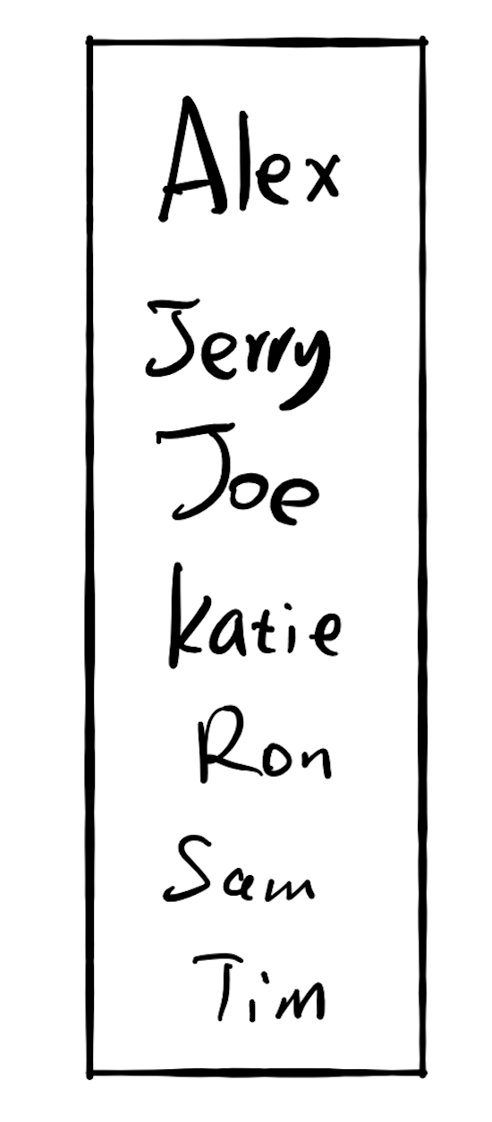

Fast for search
Slow for insertion
Slow for search
Fast for insertion

Slide 4
17.3 Do both fast?

Slide 5
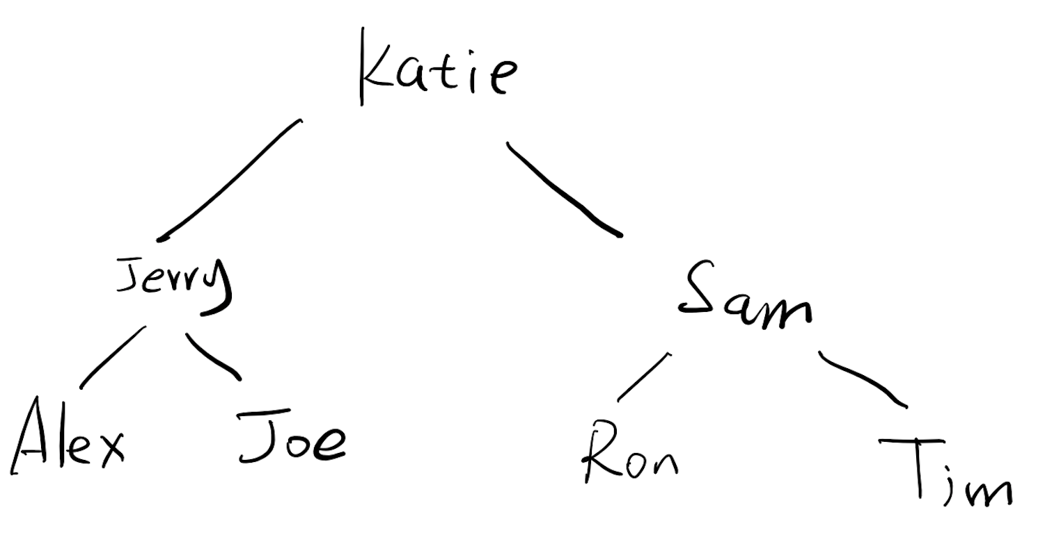
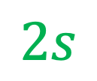
If there are 10,000 users
Each comparison takes 1 seconds
Each memory ops takes 2 seconds
Search the location:
13s
$$2s$$
Insertion:

Slide 6

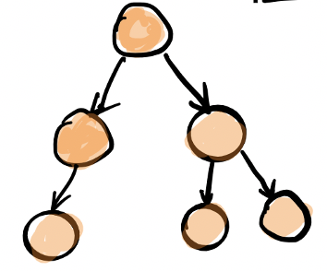
Why binary tree
Maintain ordering efficiently

Slide 7
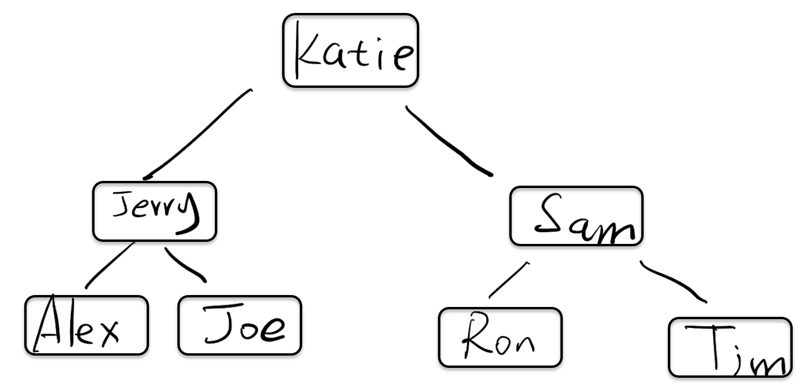
How do we implement this?

Slide 8
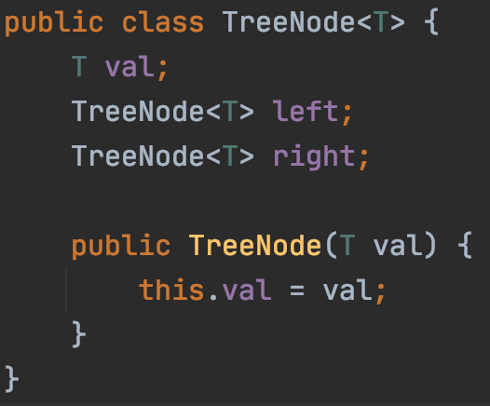

Slide 9
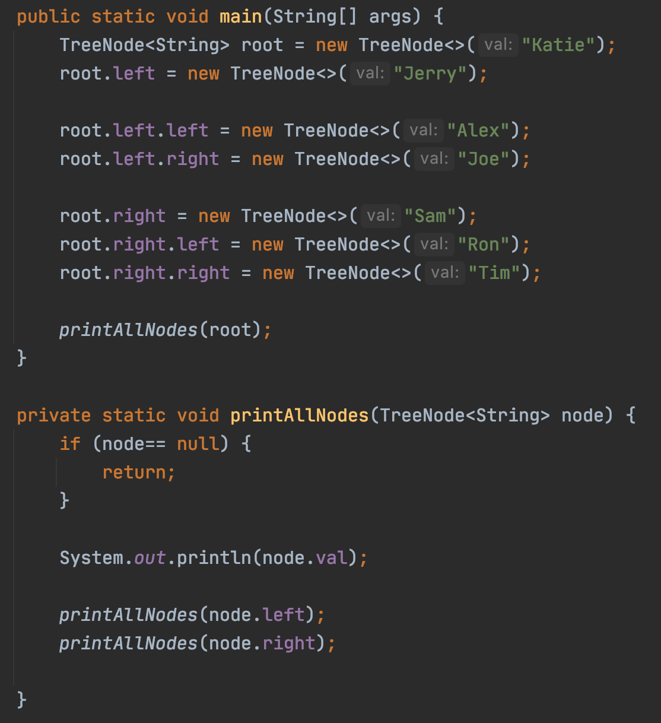
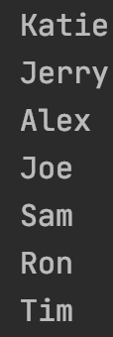

Slide 10
”Tree” vs “Sub-tree”
8
3
10
2
14
1
6
4
7

Slide 11
Binary Search Tree
A Binary Search Tree (BST) :
all the nodes follow the below-mentioned properties:
The left sub-tree of a node has a key less than or equal to its parent node's key.
The right sub-tree of a node has a key greater than to its parent node's key.

Slide 12
Exercise
Is this a binary search tree?
8
3
10
14
1
6
4
7

Slide 13
Exercise
Is this a binary search tree?
8
3
10
11
14
1
6
4
7

Slide 14
Exercise
Is this a binary search tree?
8
3
1
6
4
7

Slide 15
Exercise
Is this a binary search tree?
2
3
5
7
6
9

Slide 16
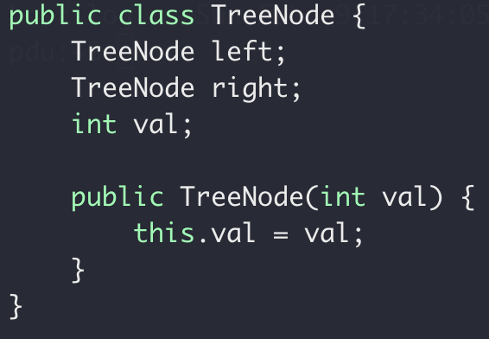
Tree Node
Implementation
Data storage:
Array
List
TreeNode
Left
Right

Slide 17
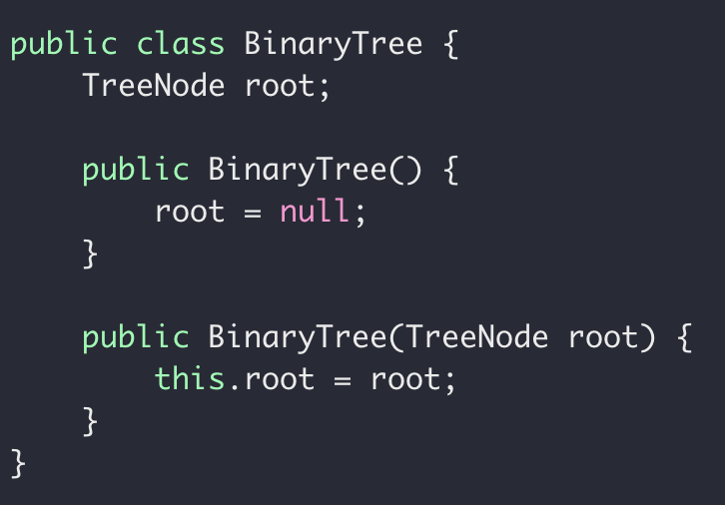
Tree ADT
Implementation
Data storage:
Array
List

Slide 18

Tree Traversal
Visit each node of a tree
1
1
2
2
7

Slide 19
Binary Tree Traversal
Pre-order: root, left, right
3
1
1
5
2
7
2
7
8
1, 2, 7
3, 1, 2, 7, 5, 8

Slide 20
Exercise
What’s the pre-order traversal of this tree?
8
3
10
9
14
1
6
4
7

Slide 21
Code it up!
preorder: Root, Left, Right
Recursion
Middle node value
preorder(left subtree)
Preorder(right subtree)
Subproblem?
Stopping condition?
Node == null

Slide 22
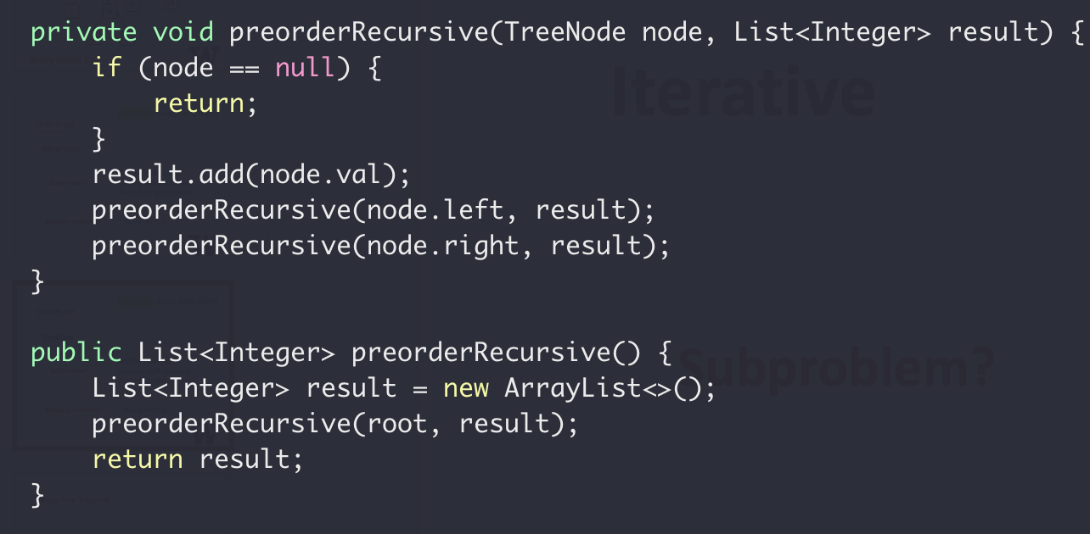
preorder: Root, Left, Right
Recursion

Slide 23
preorder: Root, Left, Right
Iterative
(without recursion)
3
2
4
Result (List):
3
2
4
Stack:
4
2

Slide 24
preorder: Root, Left, Right
Iterative
(without recursion)
While stack not empty {
3
Pop a node from Stack
Add middle node to result list
2
4
Push right node to Stack if any
Push left node to Stack if any
}

Slide 25
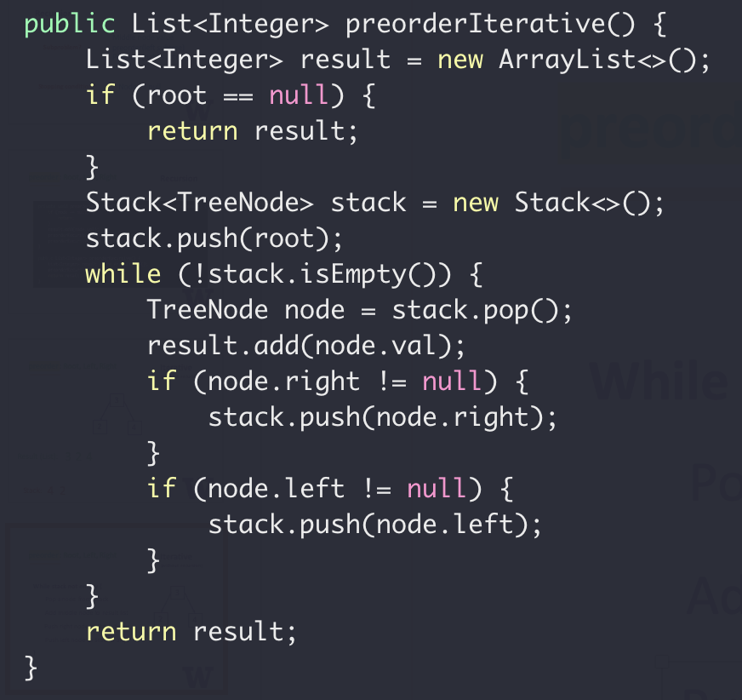
preorder: Root, Left, Right
Iterative
(without recursion)
While stack not empty {
Pop a node from Stack
Add middle node to result list
Push right node to Stack if any
Push left node to Stack if any
}

Slide 26
Pre-order Application
Target: 14
Search in a BST
?
9
9
?
3
12
1
5
10
14
?
14
7
12
18
Top down
Preorder

Slide 27
Binary Tree Traversal
In-order: left, root, right
3
1
1
5
2
7
2
7
8
2, 1, 7
2, 1, 7, 3, 8, 5

Slide 28
Exercise
What’s the inorder traversal of this tree?
8
3
10
9
14
1
6
4
7
In: 1, 3, 4, 7, 6, 8, 9, 10, 14
In: 1, 3, 4, 6, 7, 8, 9, 10, 14

Slide 29
Code it up!
inorder: Left, Root, Right
Recursion
Inorder(left subtree)
Middle node value
Inorder(right subtree)
Subproblem?
Stopping condition?
Node == null

Slide 30
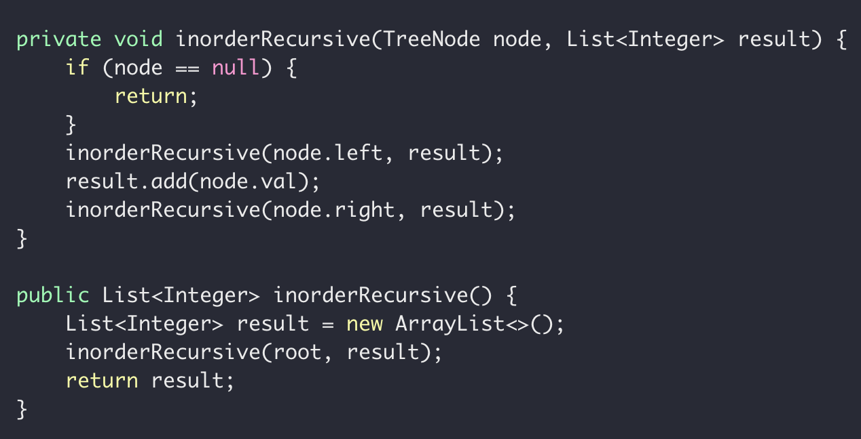
inorder: Left, Root, Right
Recursion

Slide 31
Binary Tree Traversal
Post-order: left, right, root
3
1
1
5
2
7
2
7
8
2, 7, 1
2, 7, 1, 8, 5, 3

Slide 32
Exercise
What’s the postorder traversal of this tree?
8
3
10
2
14
1
6
4
7

Slide 33
Code it up!
postorder: Left, Right, Root
Recursion
Postorder(left subtree)
Postorder(right subtree)
Middle node value
Subproblem?
Stopping condition?
Node == null

Slide 34
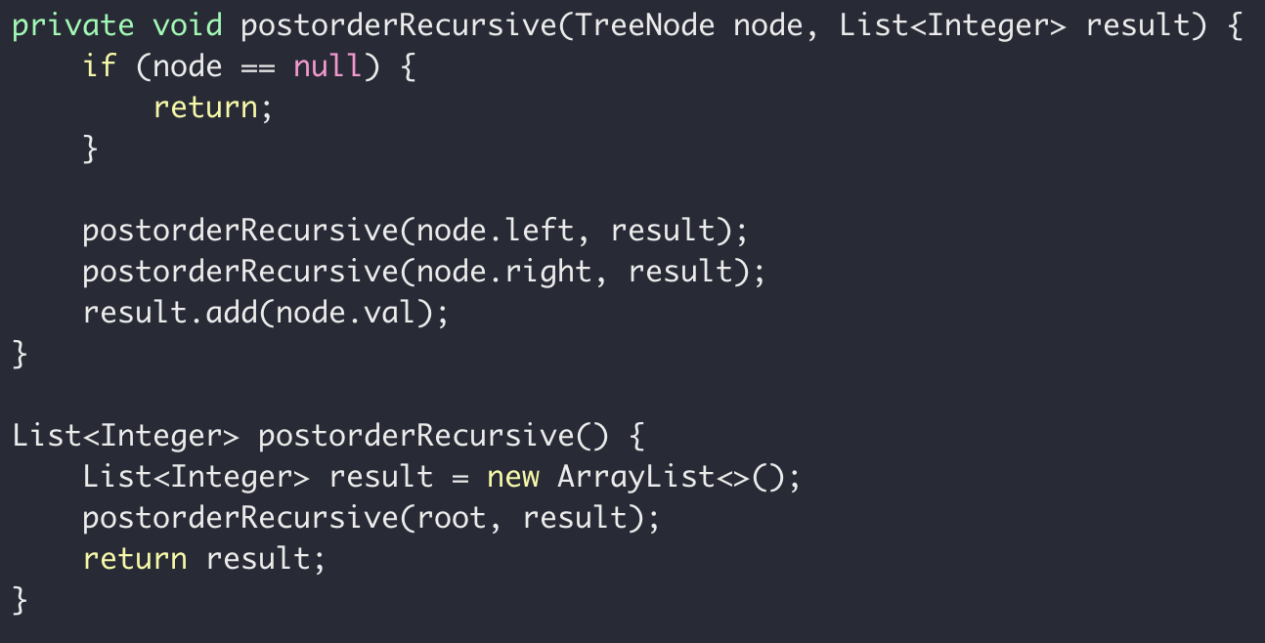
postorder: Root, Left, Right
Recursion

Slide 35
Recursion with Trees
8
3
10
2
14
1
6
4
7

Slide 36
Binary Tree Definition
3
1
5
7
Height of a tree:
Number of nodes
on the longest path
from root to leaf
5
Height = 4
3
3
3
9
1
5
1
1
5
7
Height = 3
Height = 1
Height = 2
Height = 2

Slide 37


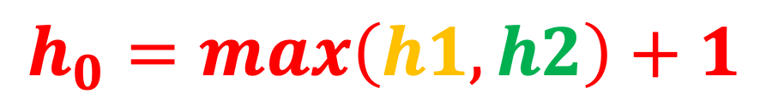


Height of a tree
$$h_{0}$$
$$h_{1}$$
$$h_{2}$$
$$h_{0}= ?$$
$$h_{0}=max\left(h1, h2\right)+1$$

Slide 38
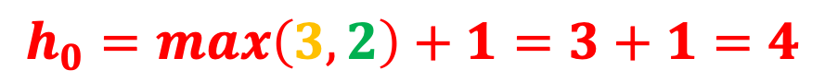

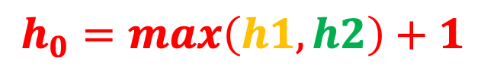





$$h_{0}=max\left(h1, h2\right)+1$$
$$h_{0}=max\left(3, 2\right)+1=3+1=4$$
$$h_{0}$$
$$4$$
8
$$h_{2}$$
$$h_{1}$$
$$2$$
$$3$$
3
10
2
14
1
6
4
7

Slide 39
Code it up!
Height of a tree
Recursion
height(left subtree)
height(right subtree)
Subproblem?
Stopping condition?
Node == null

Slide 40
Code it up!
Height of a Tree
Bottom up
Postorder
4
3
8
2
1
3
2
1
10
1
1
6
2
14
0
0
0
1
0
0
0
0
7
0
0

Slide 41
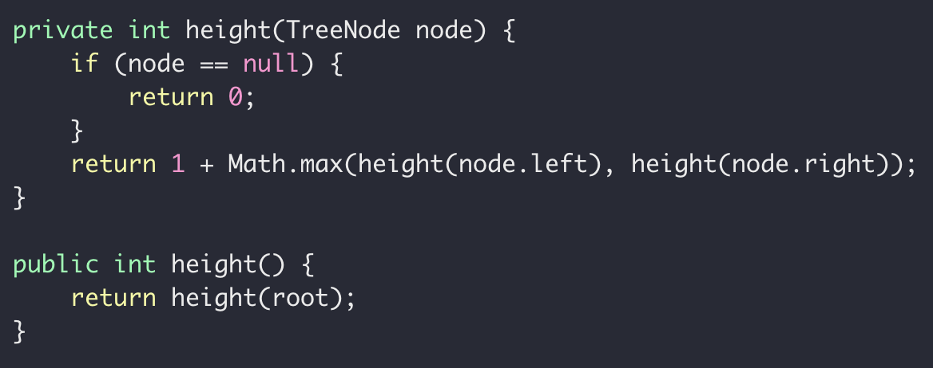
Code it up!
Height of a Tree

Slide 42
Code examples:
https://github.com/pdgetrf/array_queue/blob/WithLinkedList/src/test/java/TreeTests.java

